Slide 1
MARCH FINANCIAL/ ENROLLMENT REPORT
Board Meeting March 14, 2024

Slide 2
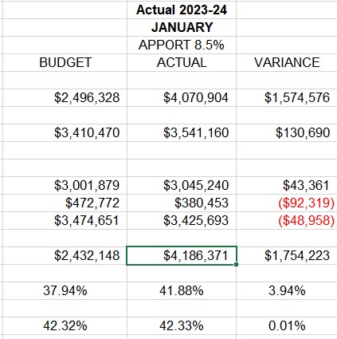
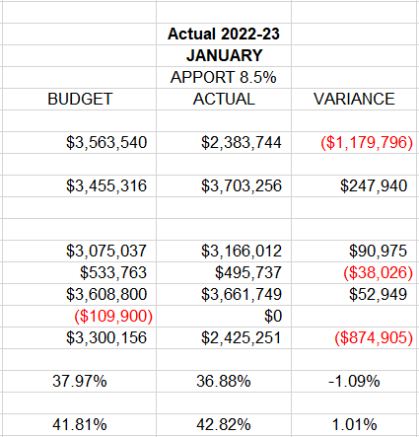
Monthly Revenues, Expenditures and Fund Balance Compared to Projected - January

Slide 3
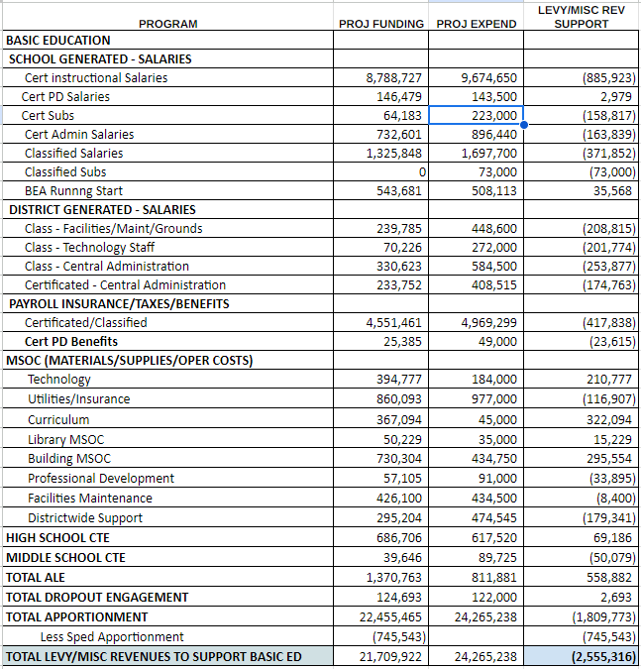
PROJECTED REVENUES, EXPENDITURES AND ENDING FUND BALANCE - BEA/DIST SUPPORT

Slide 4
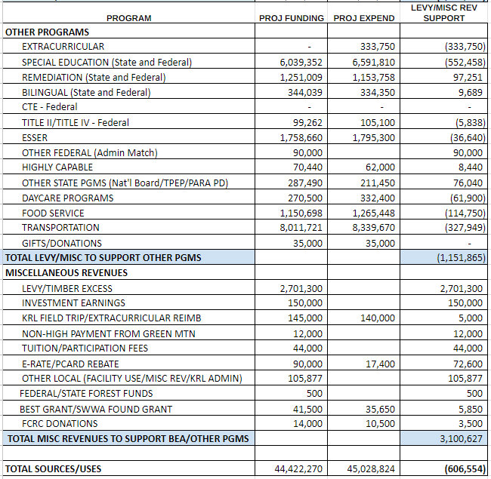
PROJECTED REVENUES, EXPENDITURES AND ENDING FUND BALANCE - OTHER PROGRAMS AND MISC REVENUES

Slide 5
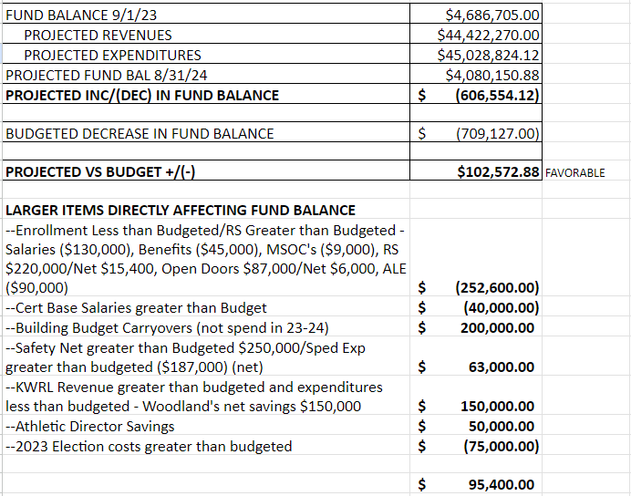
PROJECTED REVENUES, EXPENDITURES AND ENDING FUND BALANCE - SUMMARY

Slide 6
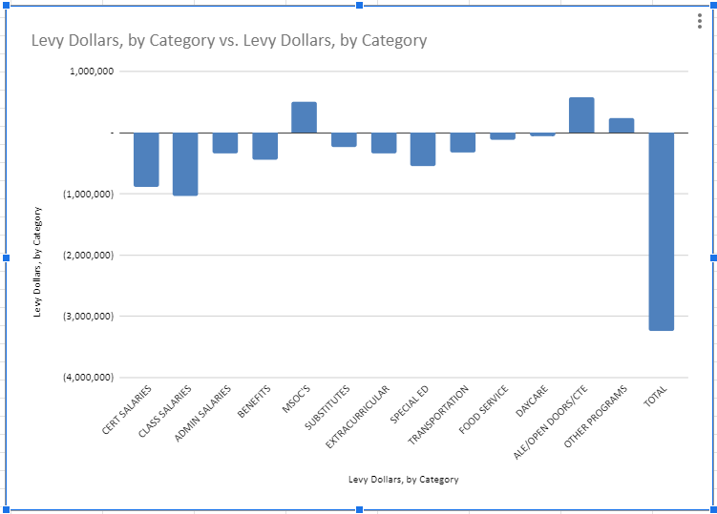
LEVY/MISC FUNDS SPENT - BY CATEGORY

Slide 7
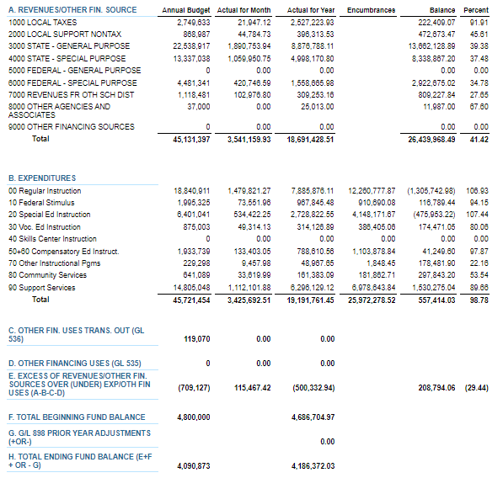
JANUARY 2024 BUDGET STATUS REPORT – GENERAL FUND

Slide 8
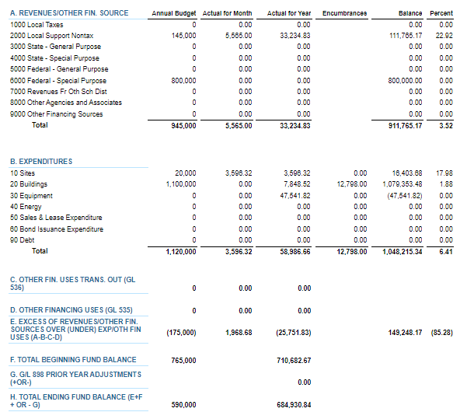
JANUARY 2024 BUDGET STATUS REPORT – CAPITAL PROJECTS FUND

Slide 9
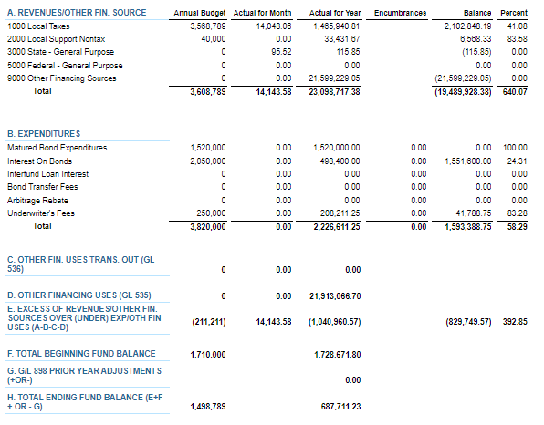
JANUARY 2024 BUDGET STATUS REPORT – DEBT SERVICE FUND

Slide 10
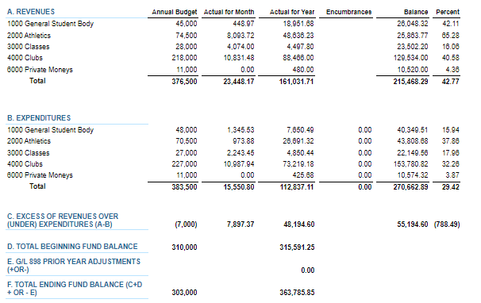
JANUARY 2024 BUDGET STATUS REPORT – ASB FUND

Slide 11
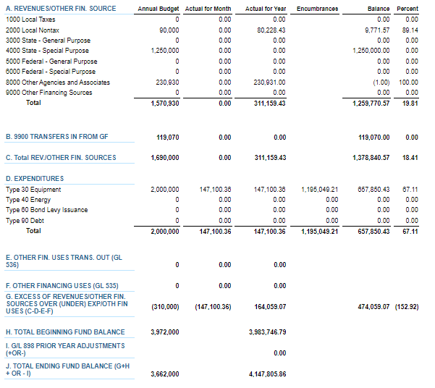
JANUARY 2024 BUDGET STATUS REPORT – TRANSPORTATION VEHICLE FUND

Slide 12
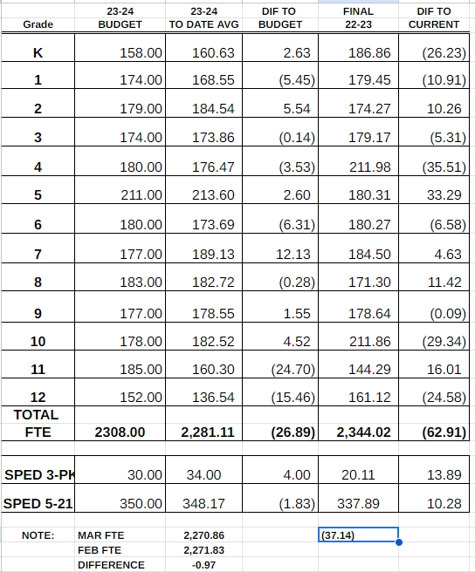
FTE ENROLLMENT – MARCH 2024

Slide 13
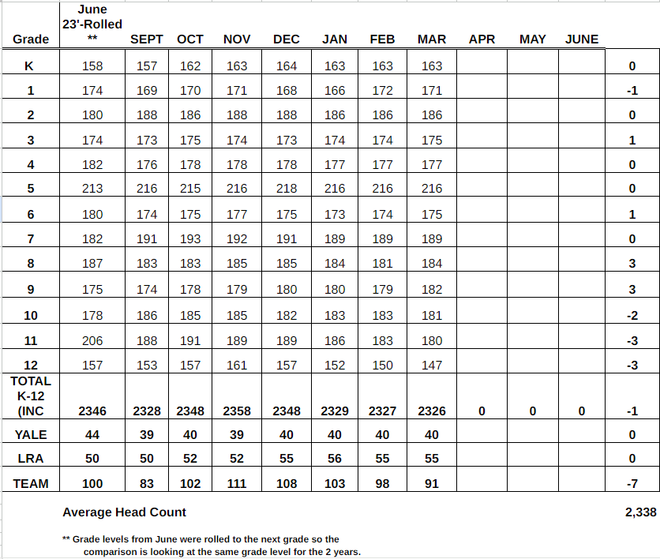
HEADCOUNT ENROLLMENT – MARCH 2024

